Slide 1
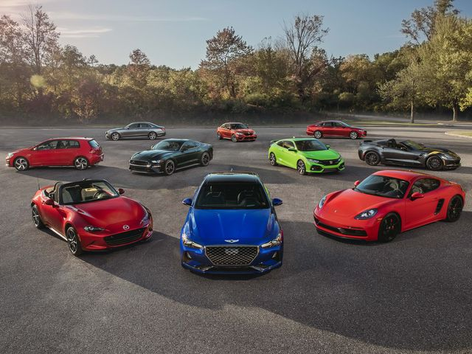
ISDS 574 GROUP PROJECT
PRICE PREDICTION FOR USED CARS
Group Members:
Alekhya Botta
Cherish Reddy
Kinjal Parikh
Minesh Barot
Prashant Sharma
Priyanka Kunder
Smriti Jain

Slide 2
AGENDA
Introduction
Problem Description & Background
EDA
Data Pre-processing
Data Mining Tasks
Results and Conclusion

Slide 3
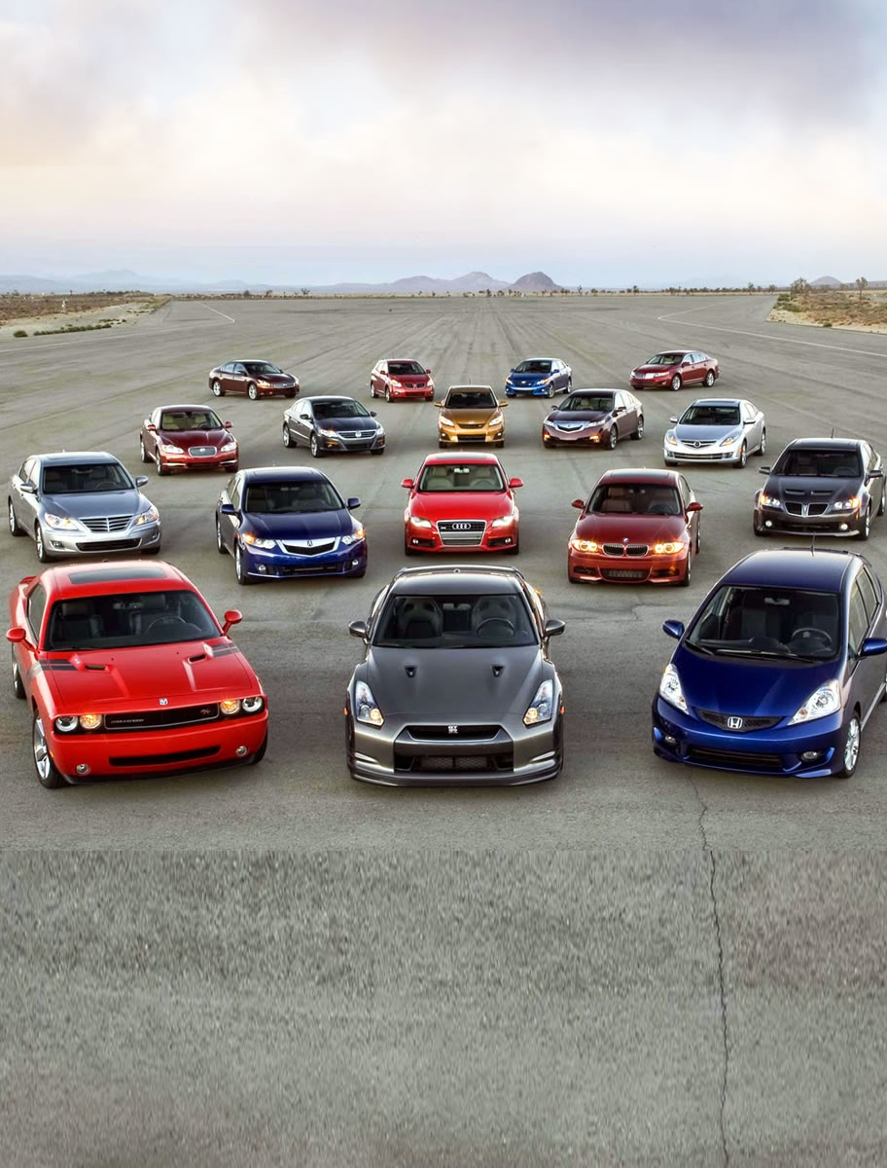
INTRODUCTION
Used car dataset
Obtained from Kaggle
Goal for the dataset
Prediction of Prices
Data Mining Techniques employed :
MLR
CART
KNN

Slide 4
PROBLEM DESCRIPTION AND BACKGROUND
Recent Market Trend
Fall in new car purchases
Resale value is always fluctuating.
Relation between variables
Positive impact
Negative Impact
Need for the model
Assistance for Craigslist and customers

Slide 5




Phases of the project
04
Interpreting the results and forming a conclusion.
03
Apply the machine learning models on the preprocessed dataset with features as inputs and the price as output.
02
Pre-process the data and identify the important features that reflect the price by performing Data Exploration.
Understanding the Data and Literature Review.
01

Slide 6
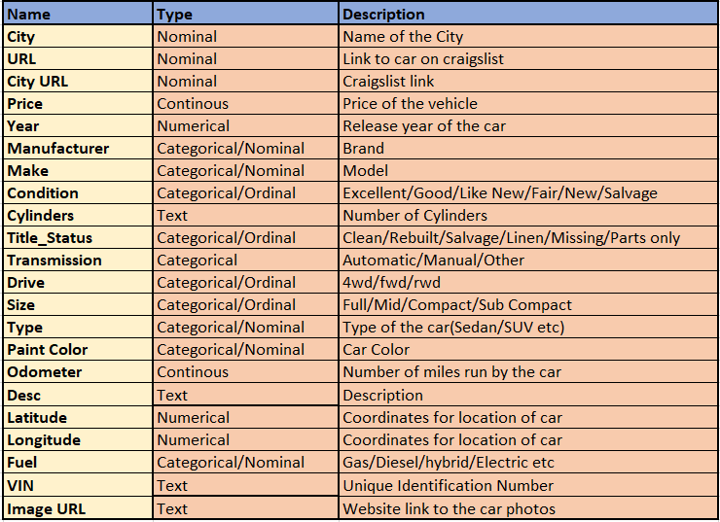
The Data

Slide 7
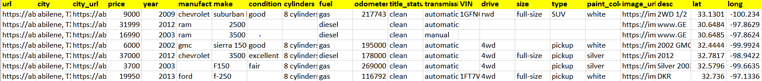

Slide 8
Data Pre-Processing
Missing Values
Text Data
Dropped the missing values
CYLINDERS – Came in a text format .Extracted the numerical value.
Outliers
Categorical Variables
PRICE :
>1000 and <100,000
ODOMETER :
>12,000 and <120,000
Regrouping and Creating Dummy Variables.

Slide 9
Data Pre-Processing
Variable | Problem | Solution
Paint Color | More than more than 10 unique values | Regrouped into two separate categories
Manufacturer | More than more than 30 unique values | Regrouped into three separate categories viz; Luxury, Budget, and Truck depending on the manufacturer.
Size | Multiple levels | Regrouped the categories based on frequency.
Type | More than more than 15 unique values | Created Dummy Variables

Slide 10
DATA EXPLORATION THROUGH TABLEAU
Target Variable : Price
Predictors: Condition, Color, Drive. Fuel, Manufacturer, Size, Transmission, Type and Odometer

Slide 11
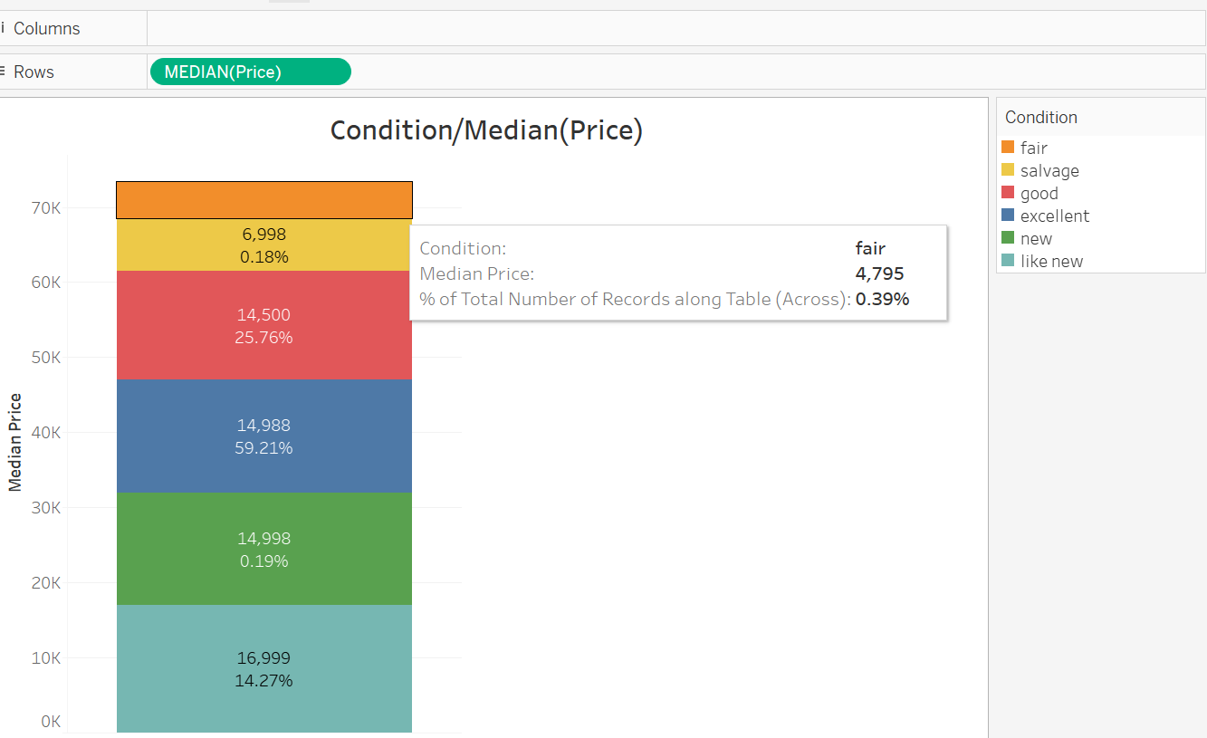
CONDITION
Here, we can see that as the condition of the car increases, the price of the car also increases. So, the price is directly dependent on the condition of the car.

Slide 12
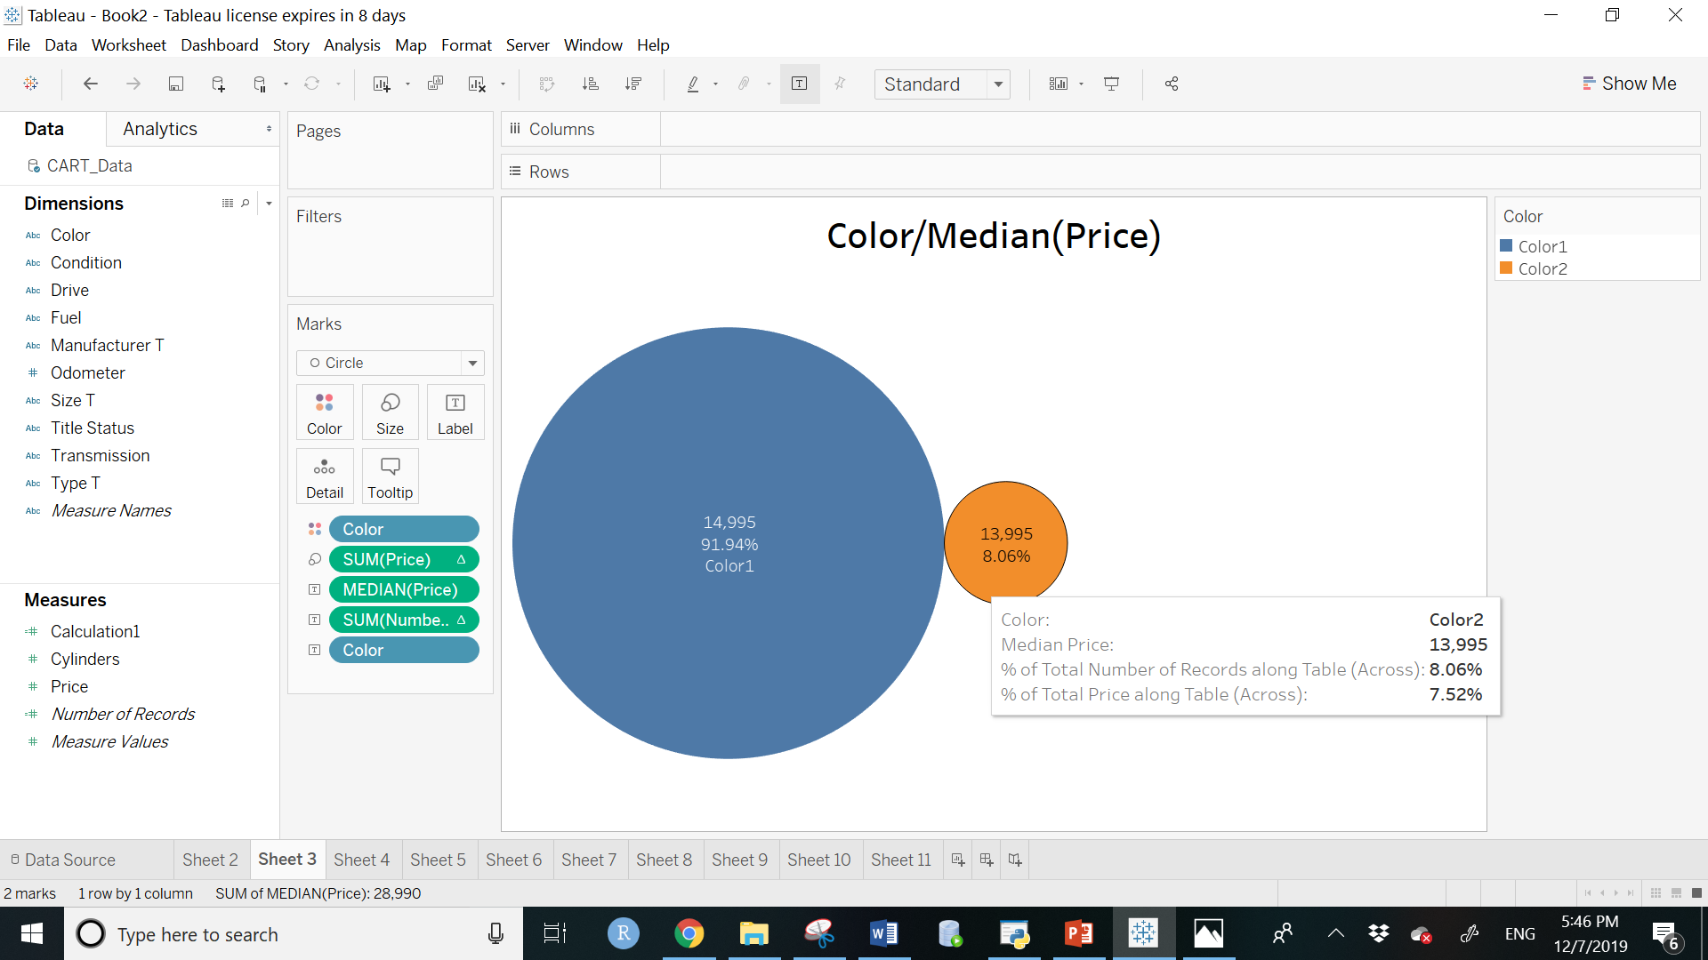
COLOR
Our dataset consists of 92% of cars which are either white, black, grey, black, blue or red in color i.e. Color1 and 8% of cars with other colors i.e. Color2.
Additionally, we can see that cars having color1 has higher prices.
From this distribution, we can say that cars having color as white, black, grey, blue, silver and red have higher prices as compared to cars of any other color.

Slide 13
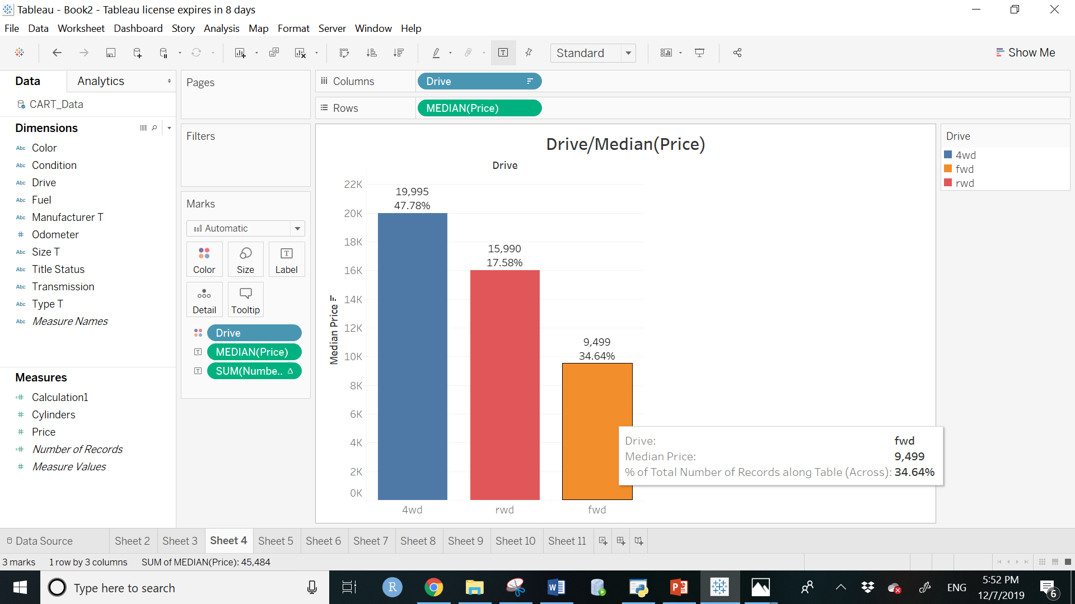
DRIVE
4wd used cars are greater in number in the dataset. 4wd forms 47.78% of the data and has a median price of $19,995.
Rwd has a median price of $15,000 and fwd has the median price of $9,499.
So, from the domain knowledge we know that, 4wd are usually costlier than rwd and fwd and our data reflects the same. Then, 4wd drive has higher prices than fwd because the cost of manufacturing is higher for 4wd drive.

Slide 14
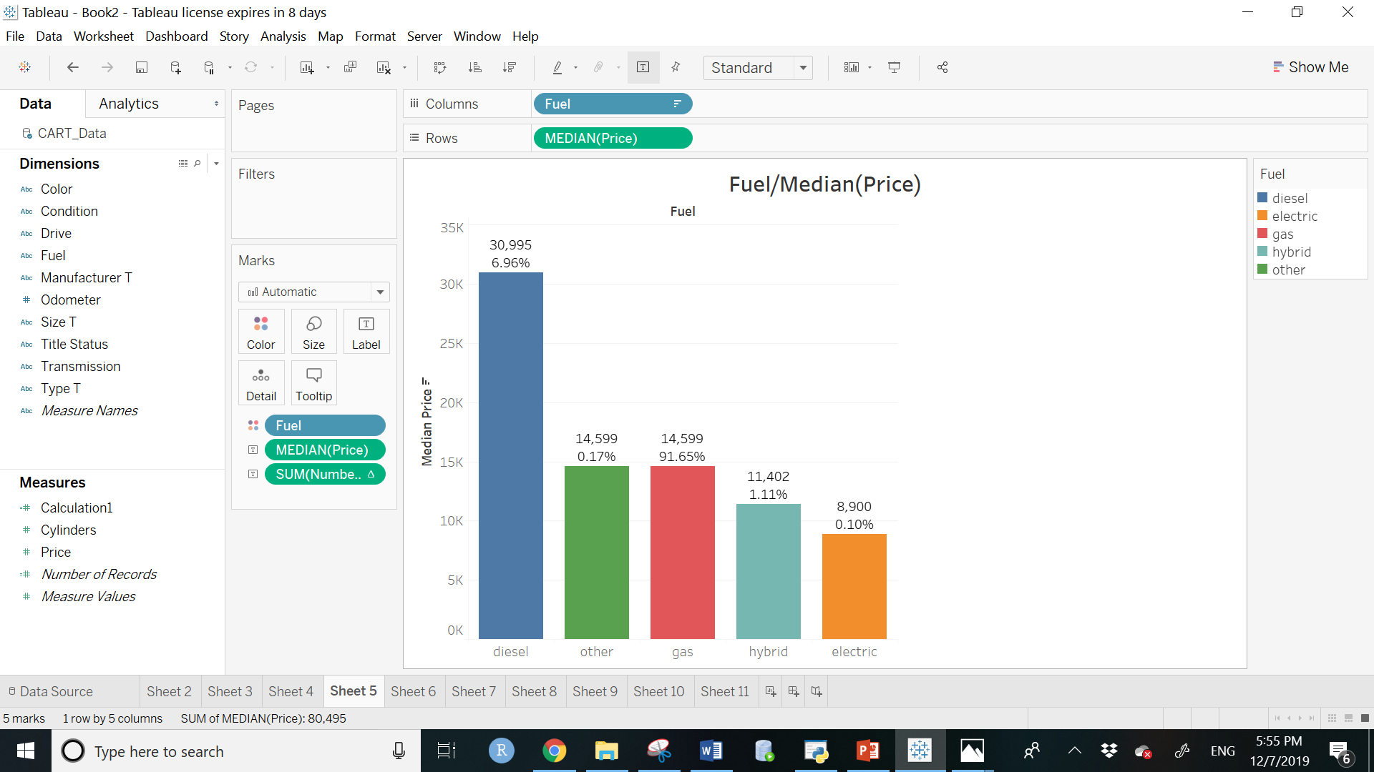
FUEL
From the analysis, we can say that cars having fuel type as diesel, gas and others have higher prices than any other fuel type.

Slide 15
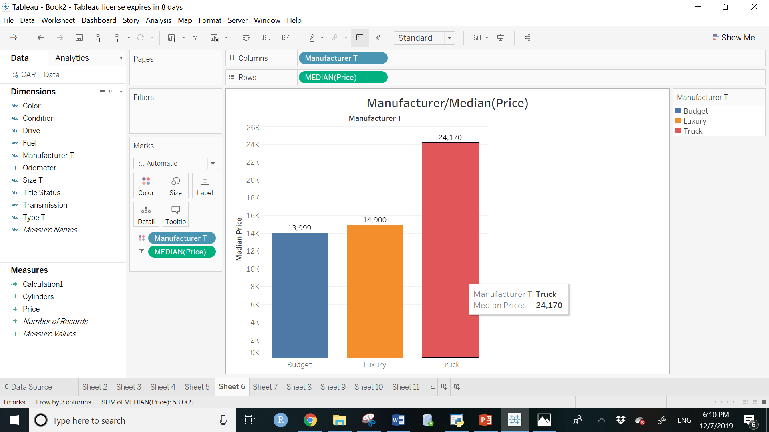
MANUFACTURER
As the name suggests we can say that budget cars have the lowest price and the trucks have the highest prices.

Slide 16
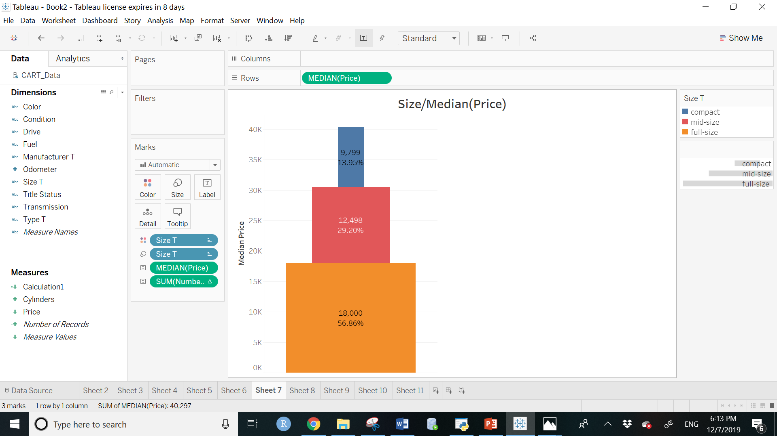
SIZE
The resale value of the car increases as the size increases. Therefore, full sized cars have the maximum value i.e. $ 18,000 whereas compact cars are priced almost half the rate of full-sized cars. Compact cars have a value of $9,799.
So, if size increases, the prices also increases

Slide 17
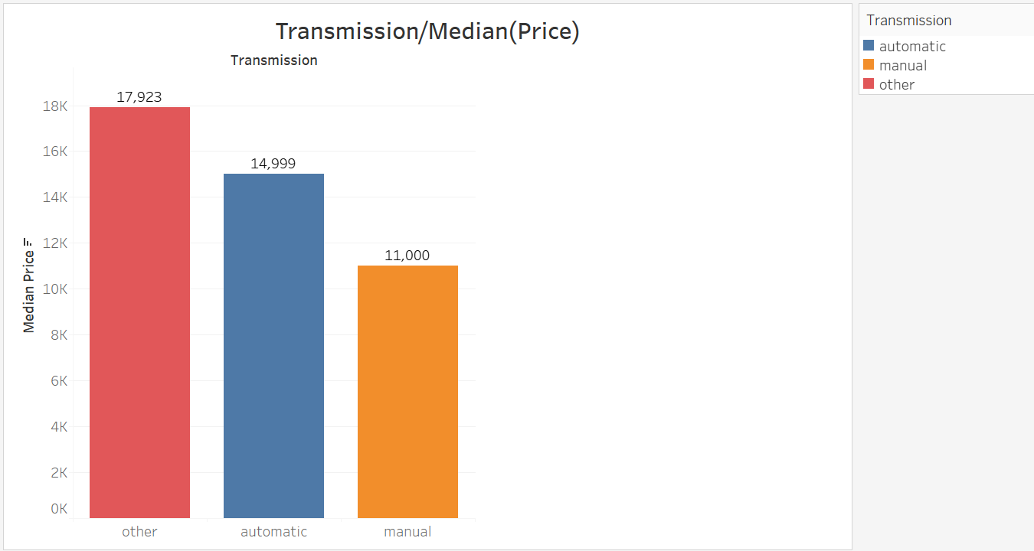
TRANSMISSION
Others transmissions could be conventional, CVT, automated manual, or dual clutch.

Slide 18
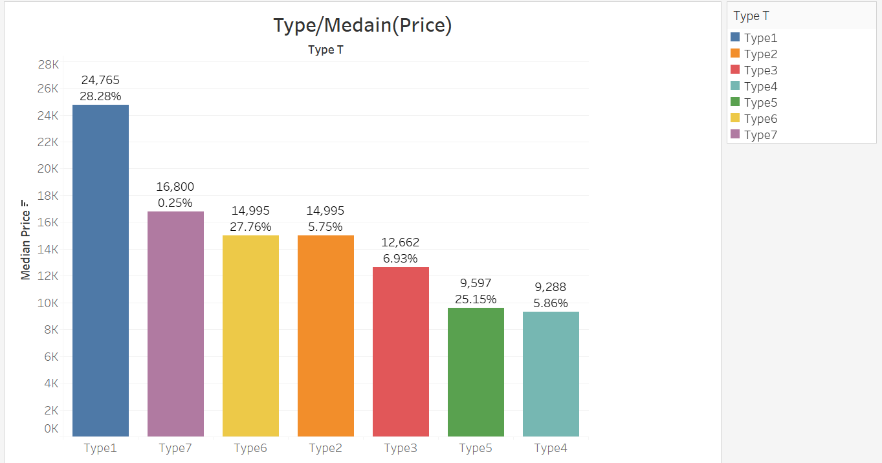
TYPE
Type 1 has the highest rate which is $24,765. (off-road, pickup, trucks, buses)
Type 4 has the lowest value which $9,288. (Sedans)
Type 7 contributes the least amount of data; however, its median price is second highest with a price of $ 16,800.
So, we can say that trucks, off road, buses and pickups cars have higher prices as compared to sedans, hatch bags, wagons and SUV’s.

Slide 19
DATA MINING TECHNIQUES

Slide 20
Multiple Linear Regression
•Multiple Linear Regression is a statistical method that helps one determine the relationship between two or more variables by identifying the independent variables and dependent variables.
•Root Mean Squared Error checks for the validity of the data
•RMSE can be defined as the standard deviation of residuals. Residual informs one about the distance between the data points and the regression line.

Slide 21
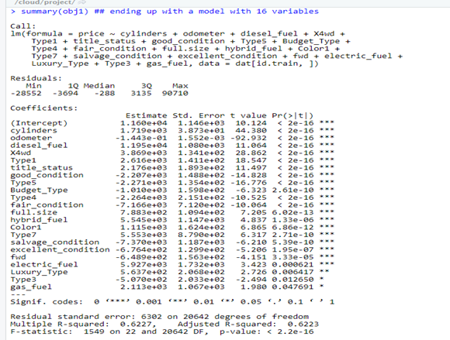
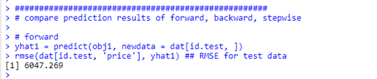
Forward Selection
•Starts with empty model
•Adds variables one after the other
•Every time a variable is added it is tested against a criteria that is et for improving the model
•No scope for improving the model; process stops

Slide 22
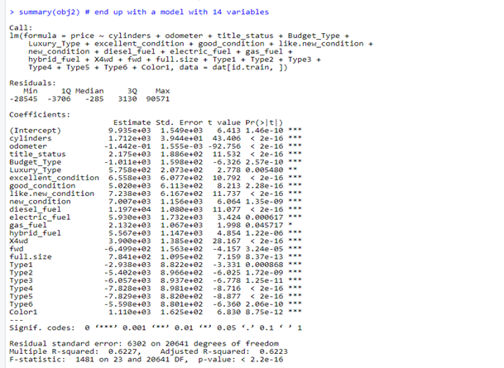
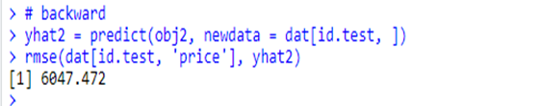
Backward Elimination
•Begins by including all the independent variables in to the equation
•Calculates how much each variable contributes towards improving the model
•If it contributes significantly to the regression equation it is kept in the model, else is deleted
•Elimination of the variables stops when no further scope of improve is left.

Slide 23
Step-wise Regression
•Combination of the forward as well as the backward selection methods
•Can begin either with all the available predictor variables or with none
•Adds as well as eliminates variables from the model
•Whenever a variable is added to the model, all the candidate variables are examined for their significance
•Depending on the significance of the variable it is kept or removed
•If it is below the specified threshold value, it is nonsignificant and is deleted from the model.

Slide 24
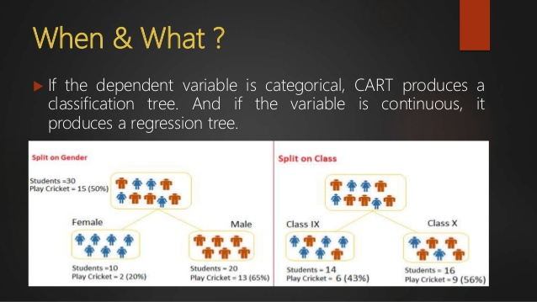
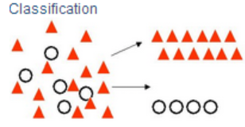
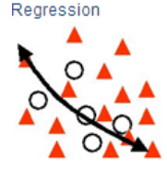
Classification and
Regression Tree (CART)
A decision tree essentials. The decision tree method is a powerful and popular predictive machine learning technique that is used for both classification and regression, hence the name Classification and Regression Tree (CART).
The CART algorithm: is structured as a sequence of questions, the answers as to which determine what the next question, if any should be. The result of these questions is a tree like structure where the ends are terminal nodes at which point there are no more questions.
Classification Trees: Where the target variable is categorical and the tree is used to identify the "class" within which a target variable would likely fall into.
Regression Trees: Where the target variable is continuous and tree is used to predict it's value.
An example to give an overview of when the tree can be classification and when the tree can be regression.

Slide 25
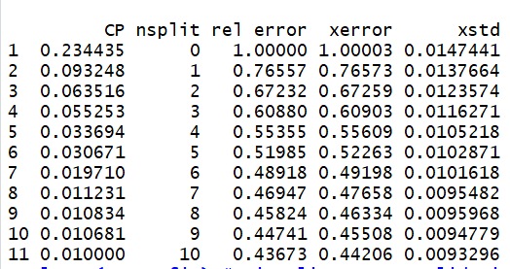
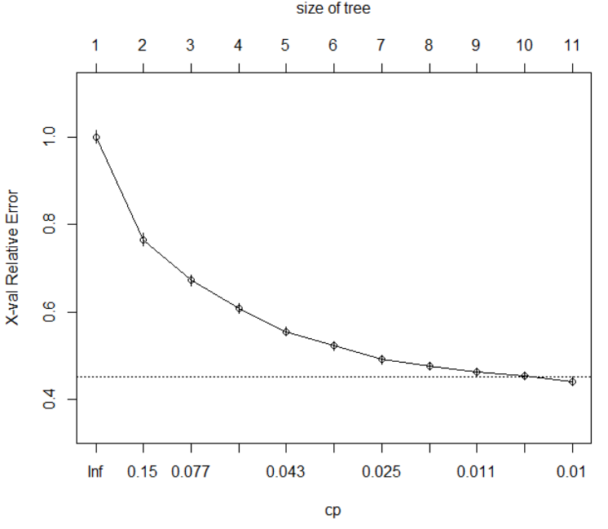
COMPLEXITY PARAMETER TABLE
Complexity Parameter Table and Plot
Based on the CP (complexity parameter) table, the minimum error tree contains 10 splits, has a complexity parameter of 0.010000 and yields an error of 0.43673. Here, the complexity parameter table is mainly used to select the total number of splits for which the CP is lowest. It is also for which the sum of the tree’s relative error along with the standard error is less than the x-val relative error. From the table we can see that the minimum error tree is 0.43673 and standard error tree is 0.0093296. on finding the sum of minimum error tree and standard error tree we get a value equal to 0.4460596 which is slightly greater that the x-val relative error of 0.44206.
COMPLEXITY PARAMETER PLOT

Slide 26
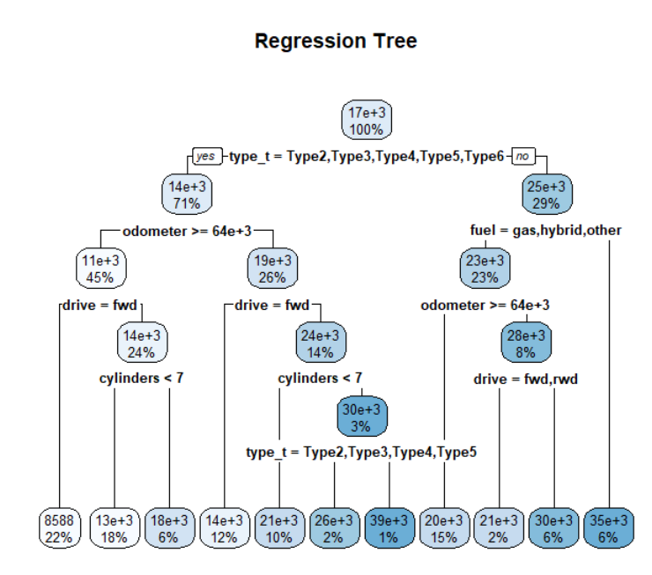
Regression Main Tree
Here, we are dividing the data into 70% training and 30% testing. The minimum tree contains similar decision nodes and terminal nodes when compared with the regression tree.
We are passing the train data (i.e the 70% of the data) to get regression main tree.
we can conclude from the graph that the regression tree contains 10 splits and 11 terminal nodes.

Slide 27
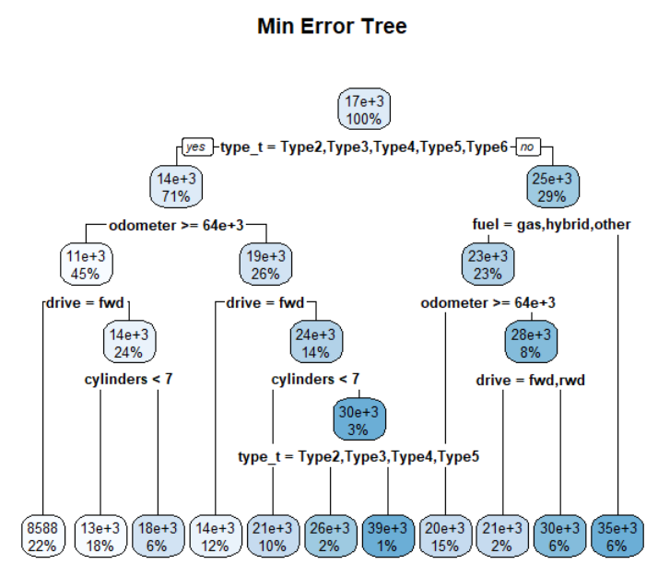

Minimum Error Tree & the RMSE value
Using the “rpart” package and the prune function from r, the regression tree is pruned based on the lowest complexity parameter that yields the lowest error.
we can conclude from the graph that the minimum error tree contains 10 splits and 11 terminal nodes.
The minimum tree contains similar decision nodes and terminal nodes when compared with the regression tree.

Slide 28
KNN Regression
How to use K-NN for Prediction (for Numerical or a Continuous Outcome)?
Used average or weighted average of response values from the k-nearest neighbors to determine predicted value in the validation set
RMSE usually used instead of the misclassification error rate to choose k.
Outcome Variable: Price
Predictors: Cylinder, Odometer, Title_status, Type, Condition, Color, Fuel, Transmission, Type

Slide 29
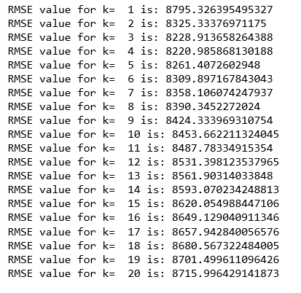


Steps Performed for K-NN
Splitting the data into test and train in the ratio of 70% and 30%.
Finding all RMSE values ranging from k=1 to k=20 nearest neighbors by making predictions.
Looking for the best k value.
Finding the Weighted Average for the target variable(continuous variable)

Slide 30
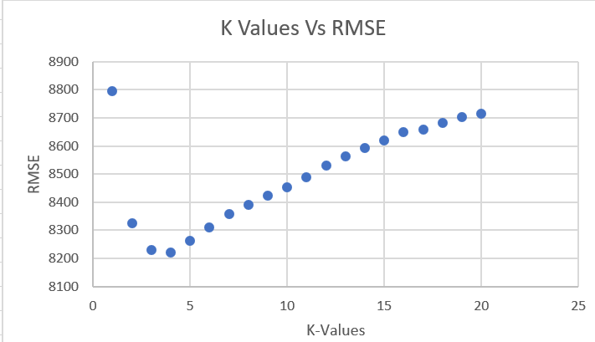
K – values Vs RMSE

Slide 31
CONCLUSION
Hence, in KNN modelling, we conclude that when we split the data into training and test into 70% and 30%, we are getting
the lowest RMSE value of 8220.9859 for the best k nearest neighbors equals 4.
Advantages and Disadvantages for K-NN Modelling
Advantages | Disadvantages
Simple and intuitive. No assumptions required about data. Can be very powerful with a large training set. | Required size of training set increases exponentially with # of predictors, p

Slide 32
Data Mining Technique Results
RMSE = 6047.269
RMSE = 6564.735
RMSE = 8220.986
1
2
3
Multiple Linear Regression
CART
K-Nearest Neighbors

Slide 33
RESULTS
Relationship between RMSE and Prediction:
Lower the RMSE value, better is the prediction rate of the model.
The graph indicates the lowest RMSE value depicted by multiple linear regression at 6047.269.
Thus, proving the that prediction made by this model is more accurate than other models.

Slide 34
CONCLUSION
This analysis helped us understand the data validation for the used-cars in the United States.
The concept of RMSE value is utilized to evaluate the efficiency of prediction.
This tool can be used in the real-life by the car dealers to maximize their sales, manage their stock efficiently, provide the customer with the best possible price and build a long-lasting relationship down the line.

